Slide 1
Exercise 9
The Fungi

Slide 2
In this lab you observed a variety of Fungi. You will be expected to classify each organism into the appropriate phylum and understand the role it plays in its environment. As you review the images on this page, you should be able to identify the structures listed in bold face in your manual, know their functions and recognize reproductive structures as involved in sexual or asexual reproduction.

Slide 3
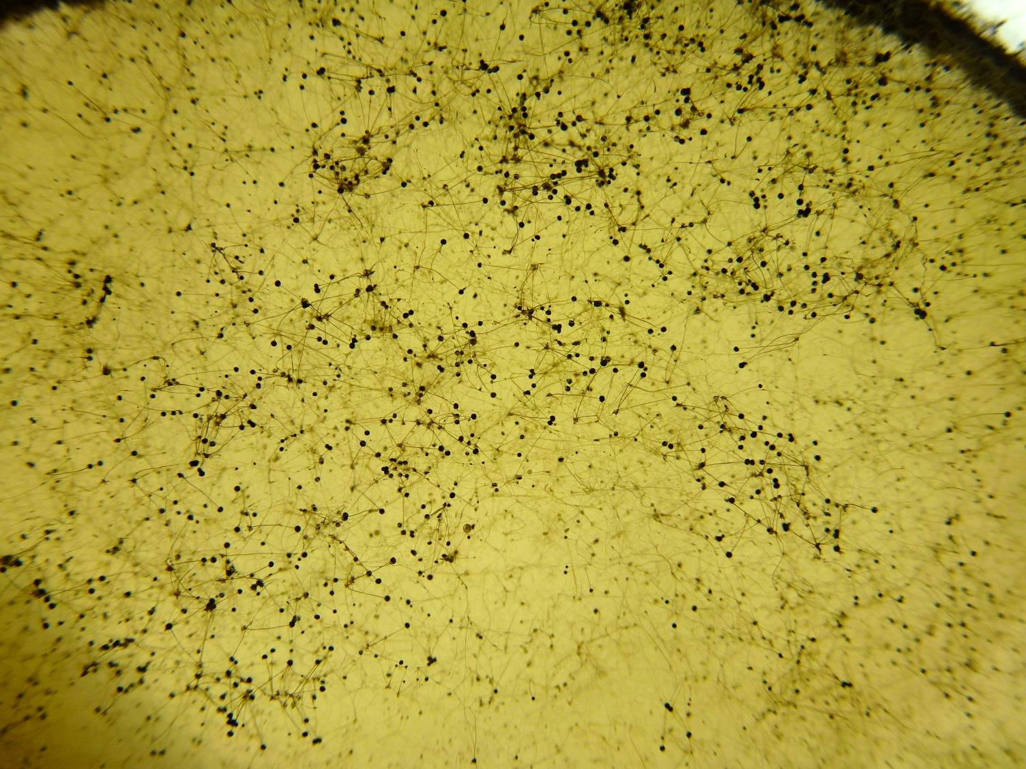
Live Rhizopus

Slide 4
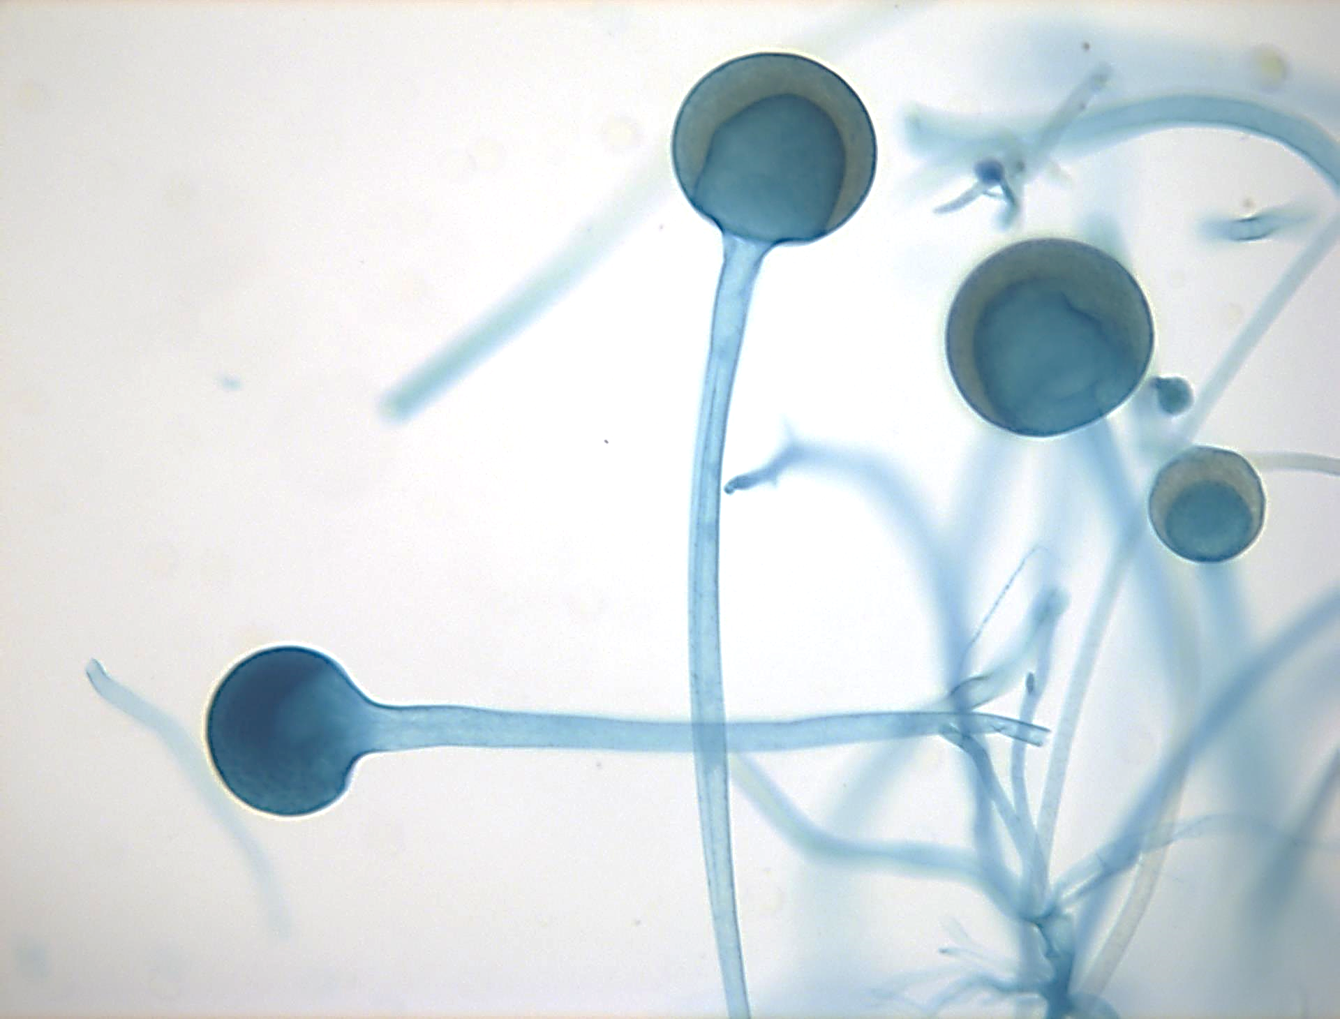
Rhizopus Sporangium

Slide 5
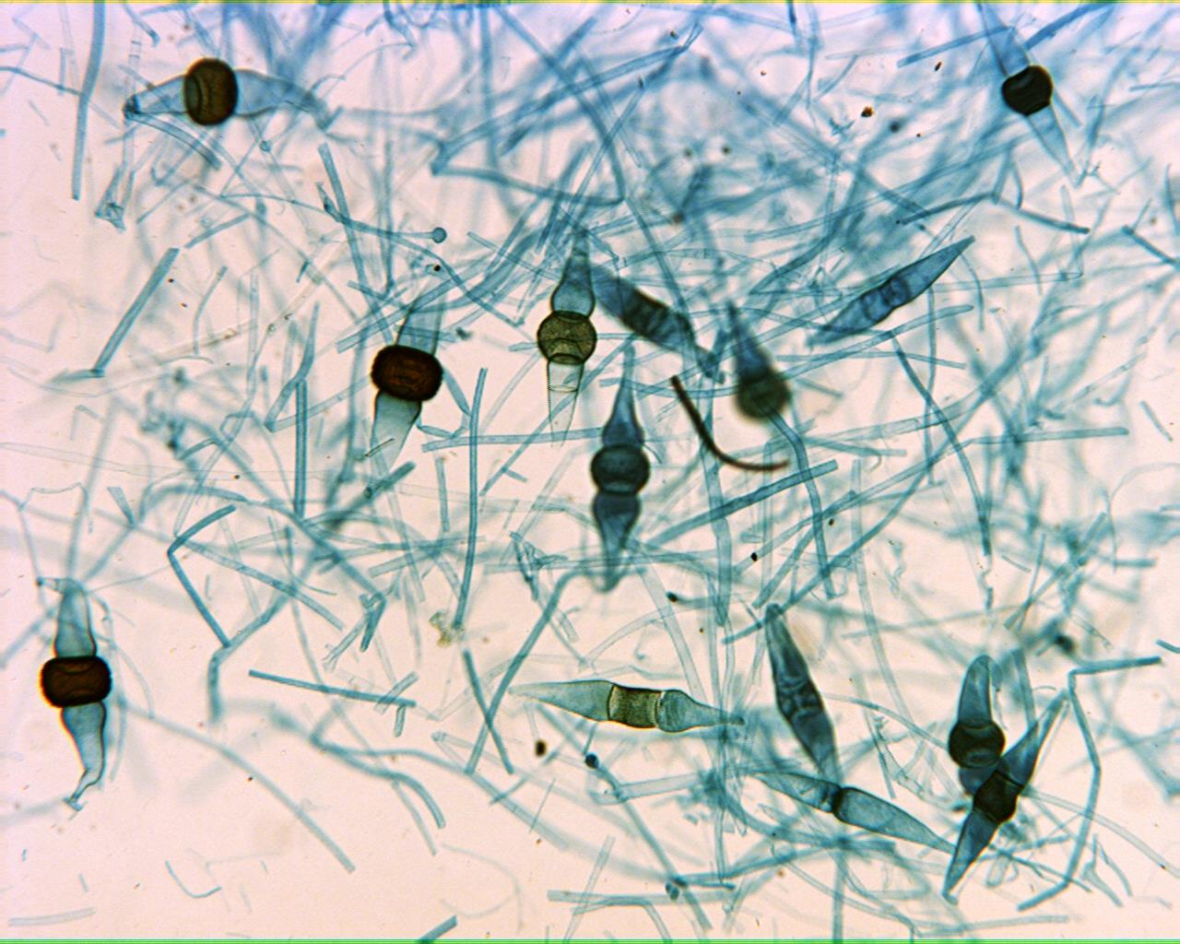
Rhizopus Zygosporangia 40X

Slide 6
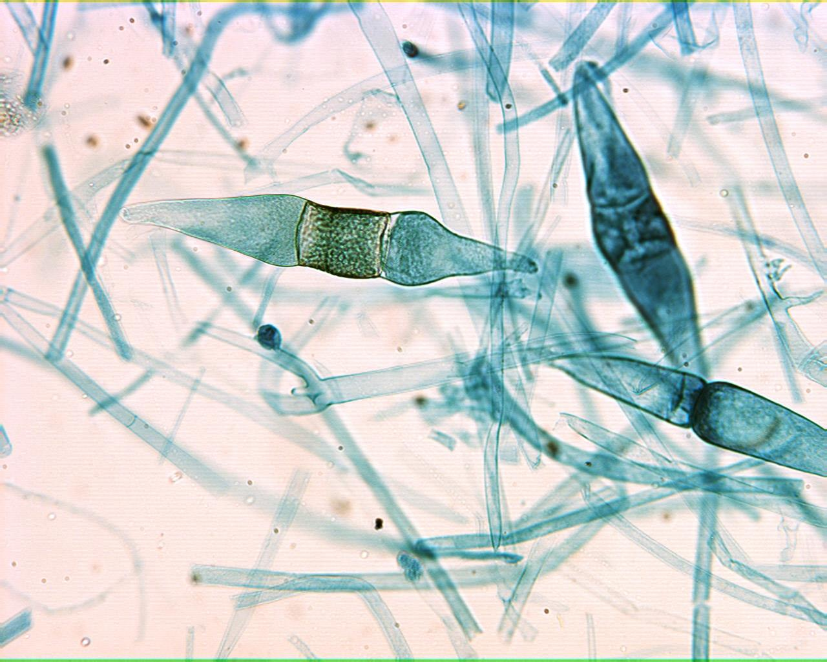
Rhizopus Young Zygosporangia 100X

Slide 7
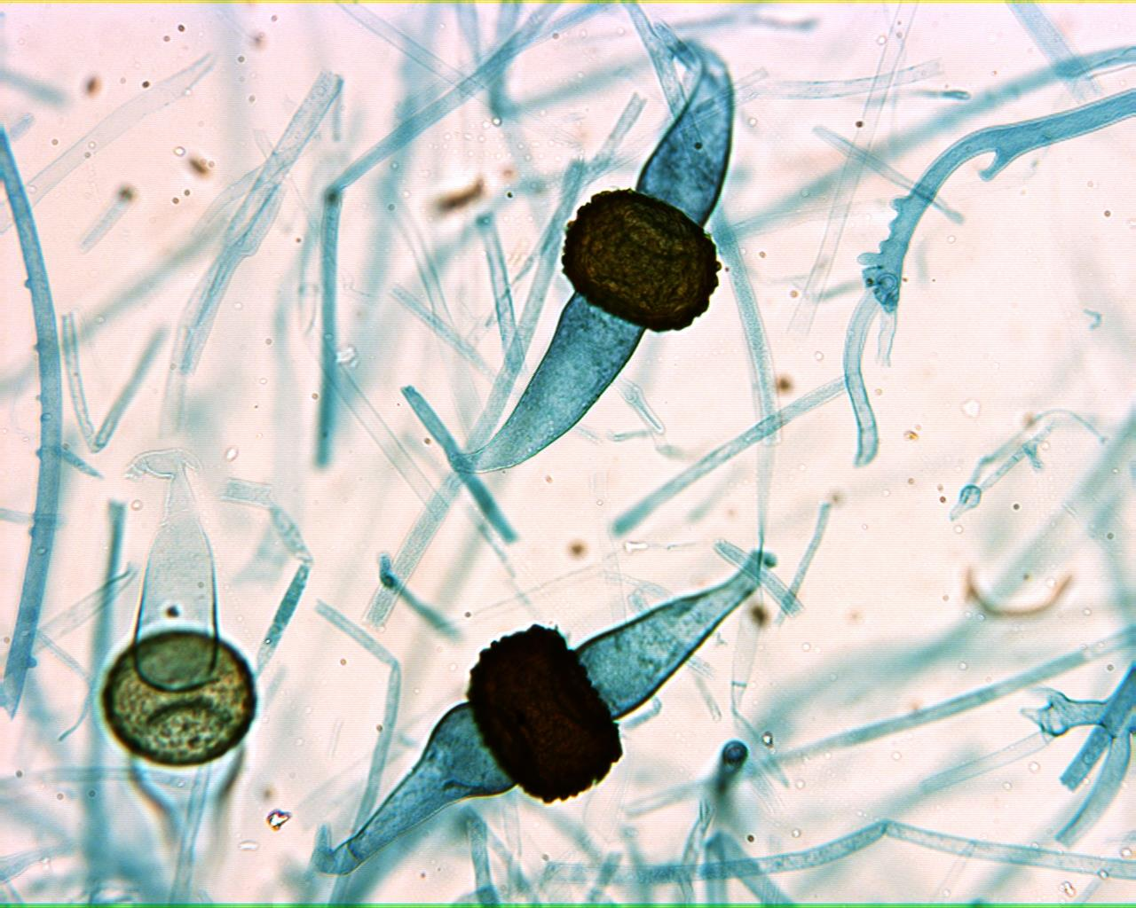
Rhizopus Mature Zygosporangia 100X

Slide 8
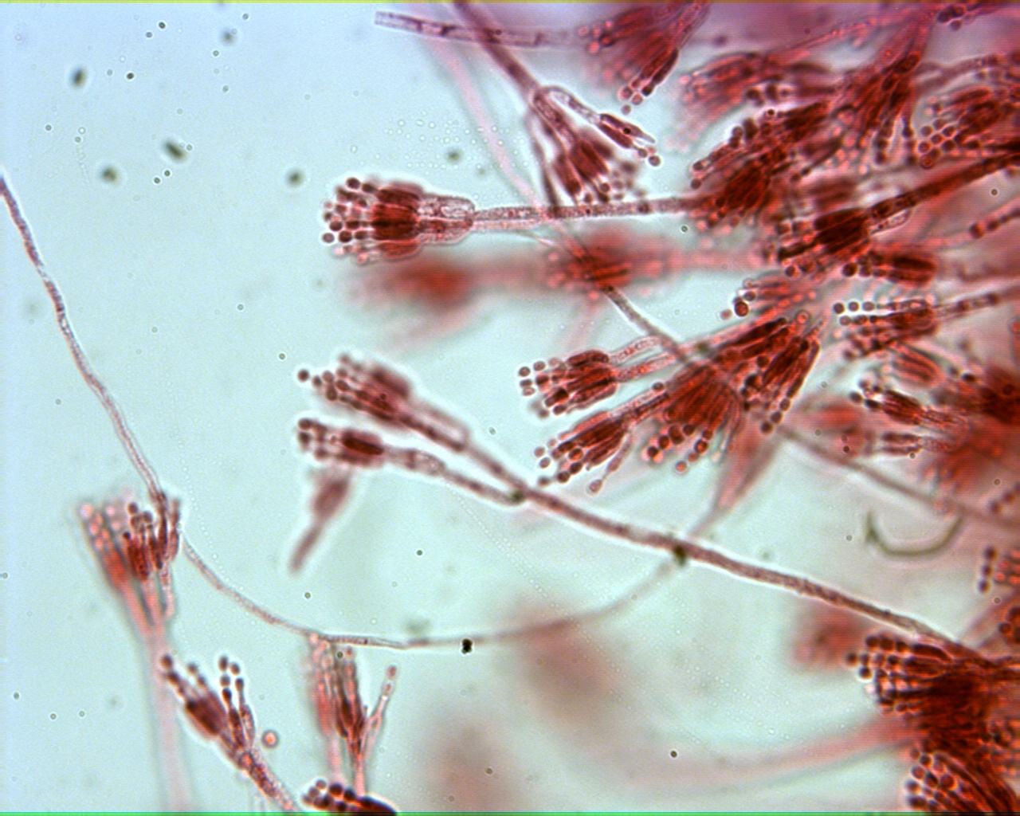
Penecillium

Slide 9
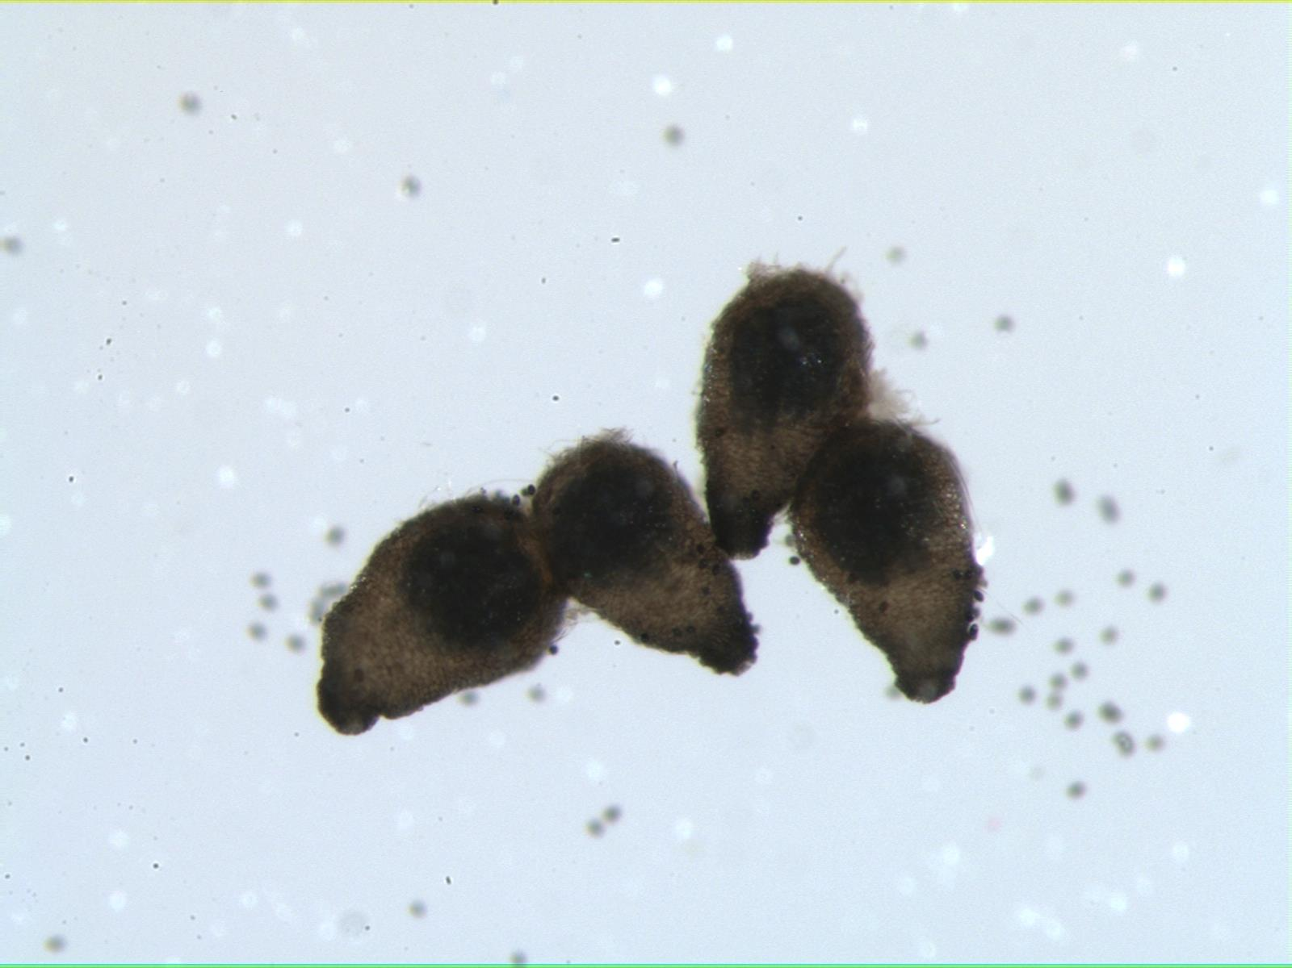
Sordaria Ascocarps

Slide 10
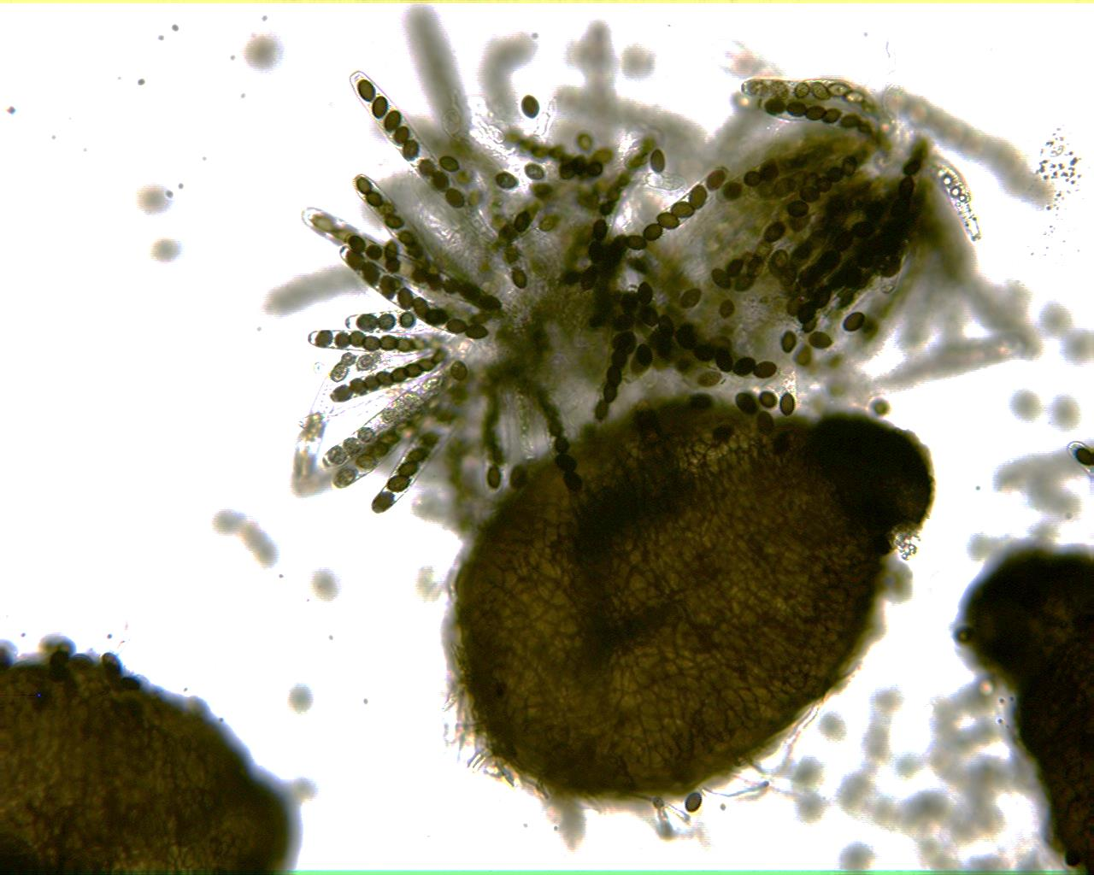
Sordaria Asci

Slide 11
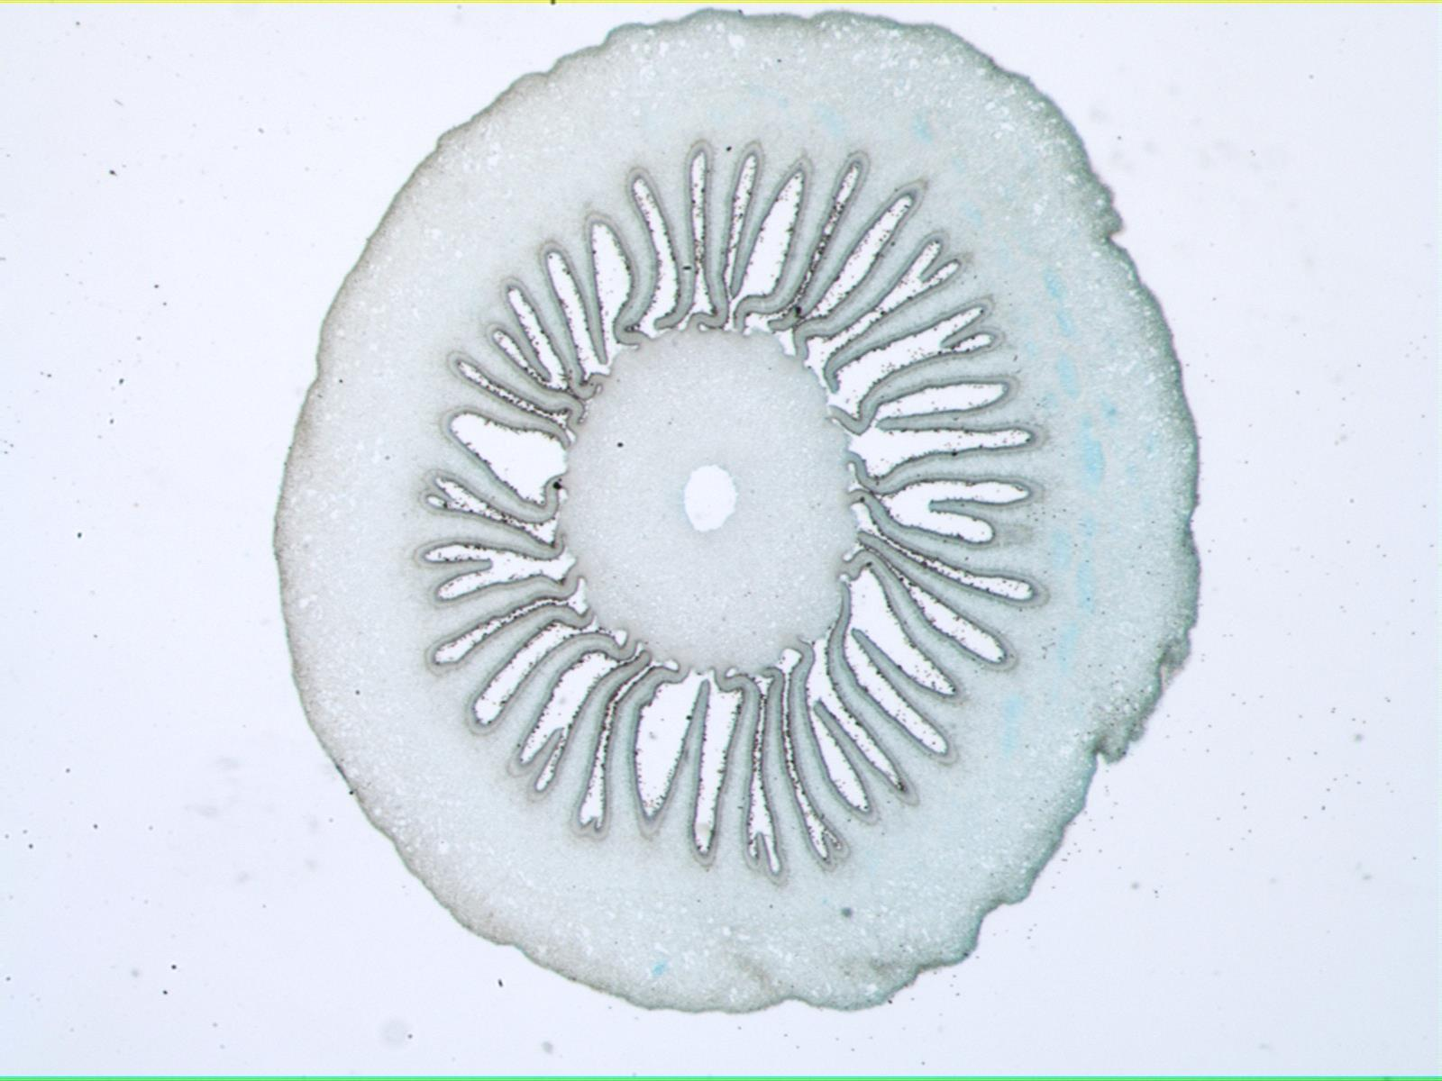
Coprinus 30X

Slide 12
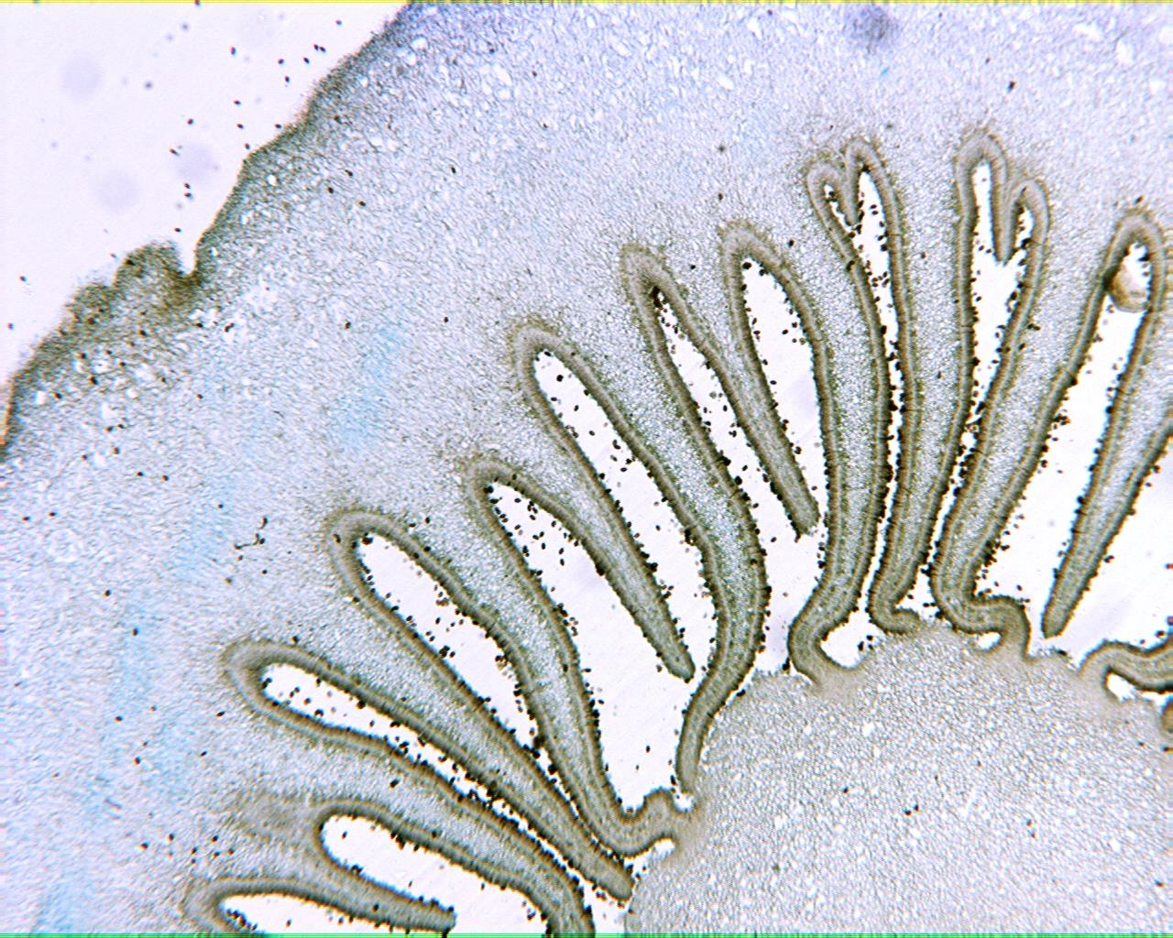
Coprinus 40X

Slide 13
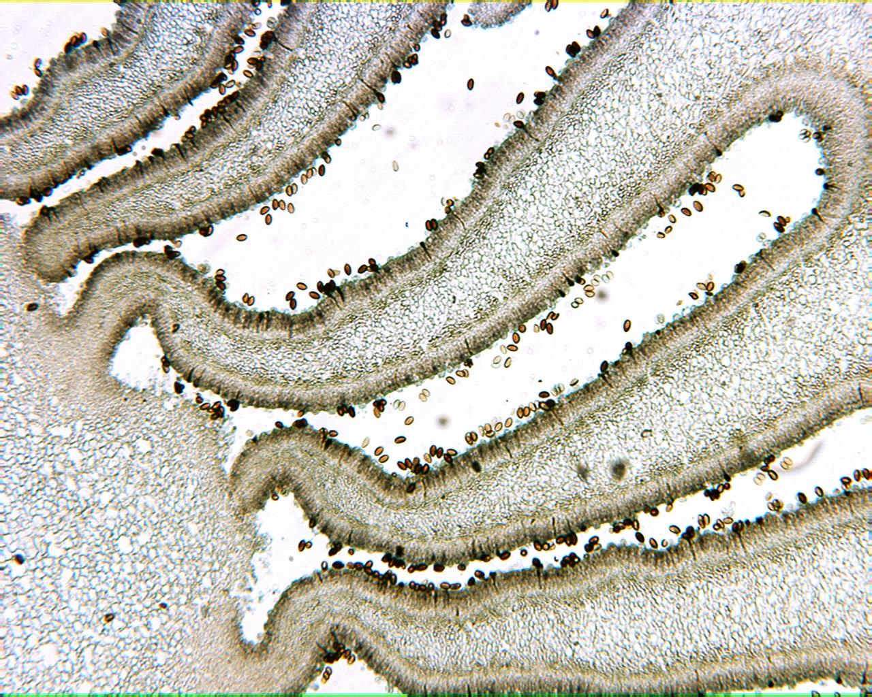
Coprinus 100X

Slide 14
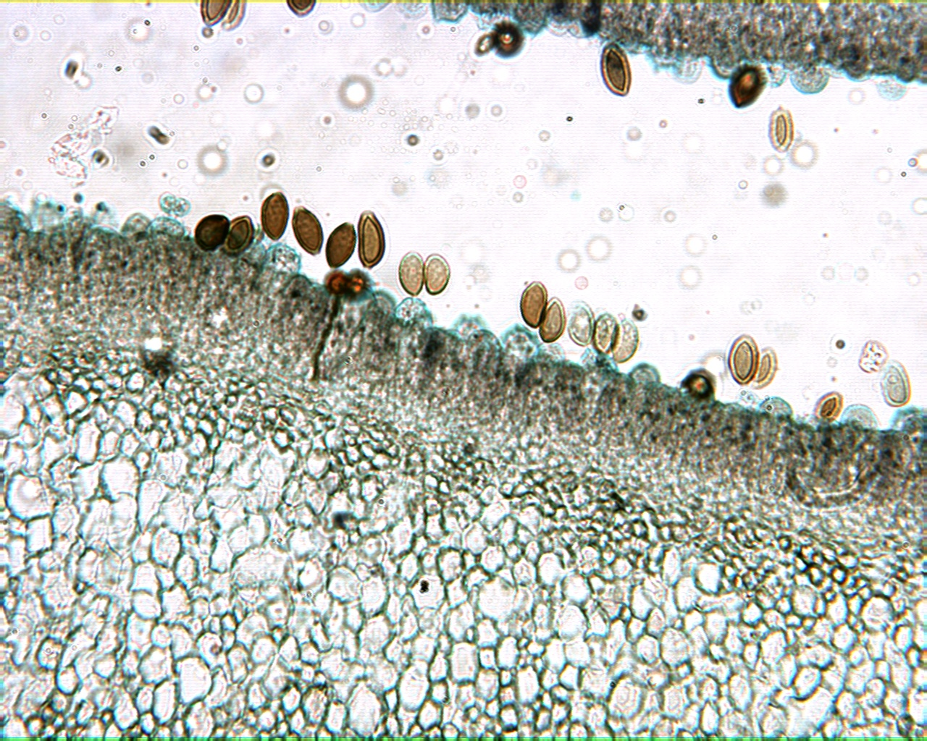
Coprinus 400X

Slide 15
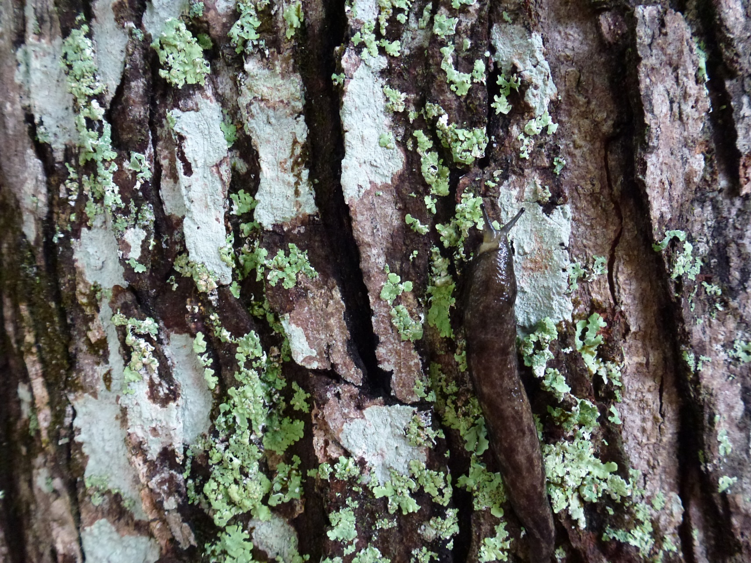
Live Lichen

Slide 16
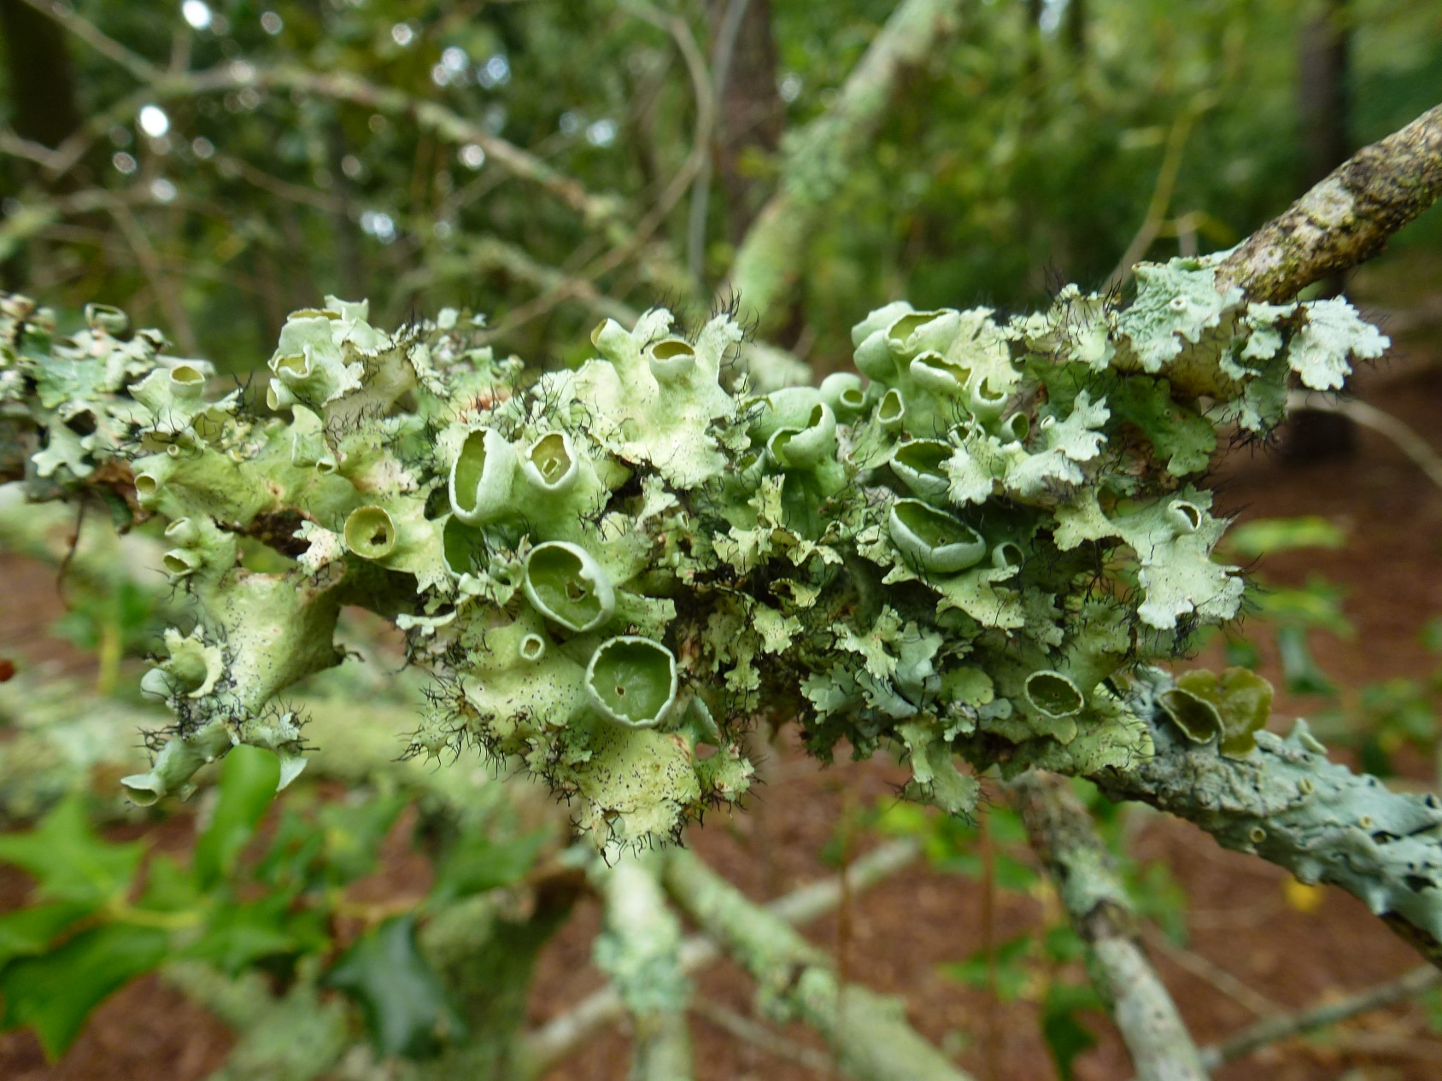
Live Lichen

Slide 17
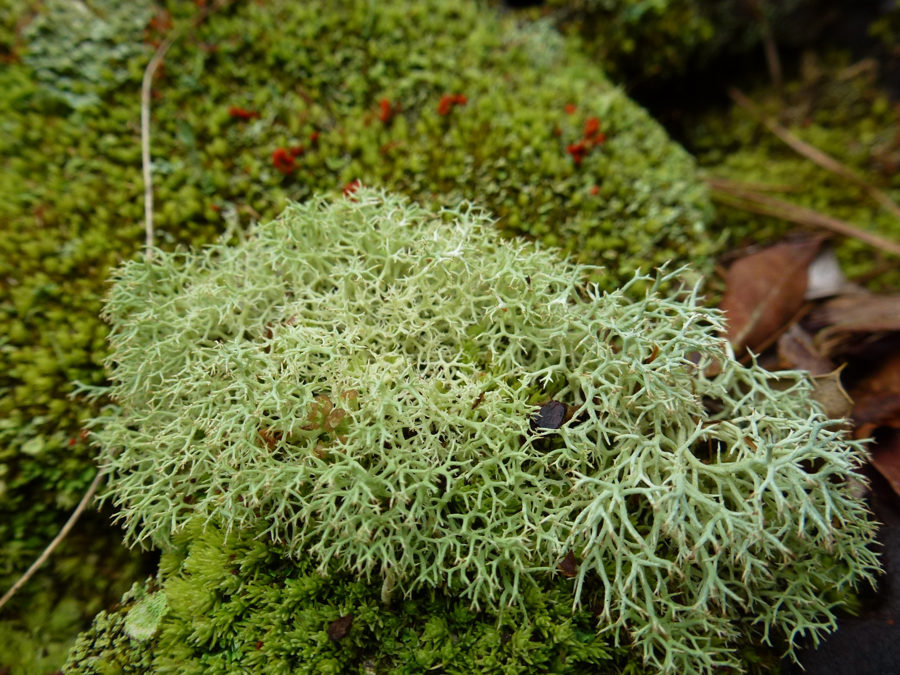
Live Lichen

Slide 18
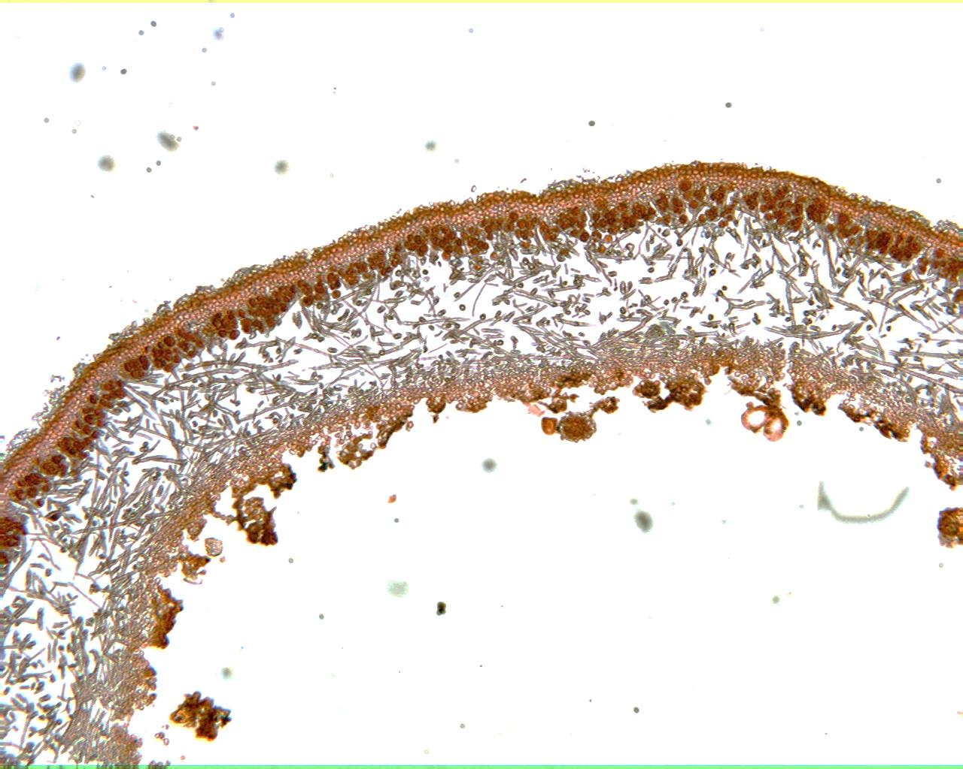
Lichen 100X

Slide 19
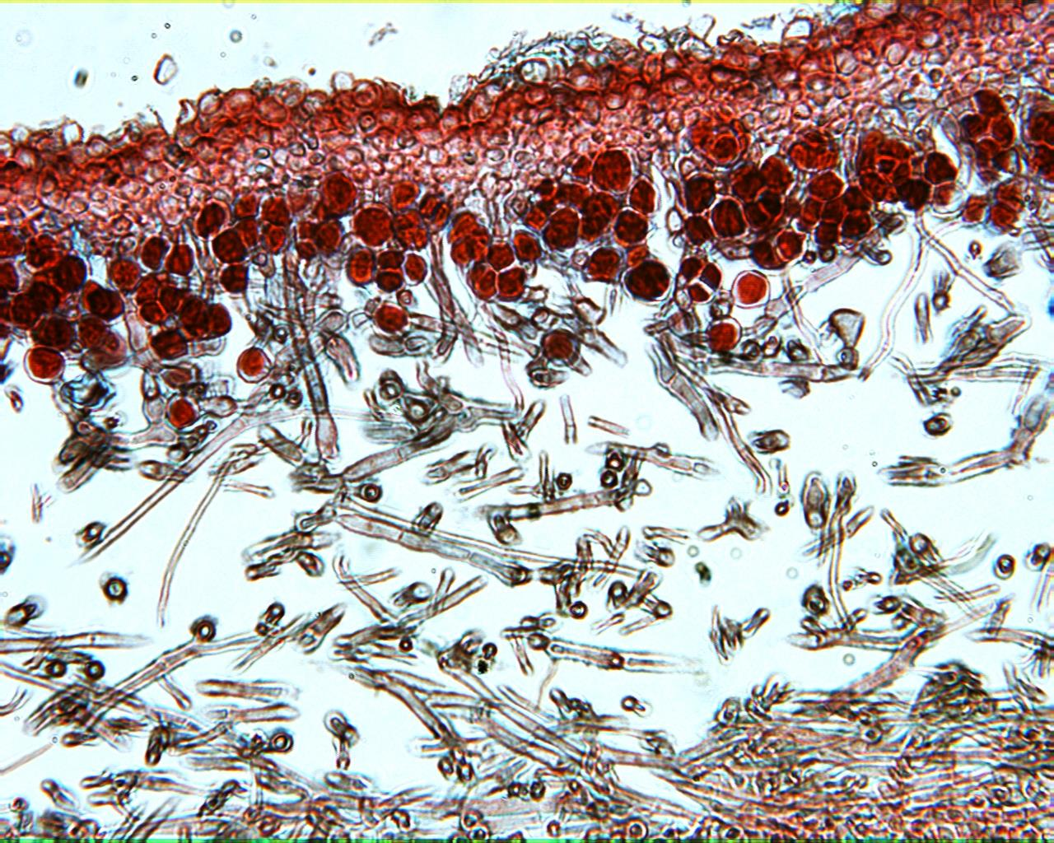
Lichen 400X

